Slide 1
AzureML Walkthrough A Data Journey
October 16th, 2017

Slide 2

Gold Application Development
Gold Cloud Platform
Gold Cloud Productivity
Gold Data Analytics
Gold Data Platform
Gold Datacenter
Gold Enterprise Mobility Management
Gold Hosting
Silver Cloud Customer Relationship Management
Silver Collaboration and Content
Silver Digital Advertising
Silver Intelligent Systems
Silver Messaging
Silver MidMarket Solutions Provider
Silver Small and MidMarket Cloud Solutions
Silver Windows and Devices

Slide 3
WHO WE ARE
Global Services
Valorem helps clients realize value through business technology solutions. Collectively our people have worked with thousands of enterprises around the world delivering innovative, insightful and technical services.
Recent Awards
CRN: 2017 Fast Growth 150
CRN: 2017 Solution Provider 500
KC Business Journal: 2017 Info Systems Firm (#4)
KC Business Journal: 2016 Fastest Growing
Redmond Channel Partner: 2016 Top 200 US MS Partners
Microsoft DX EIP Elite Partner

Slide 4

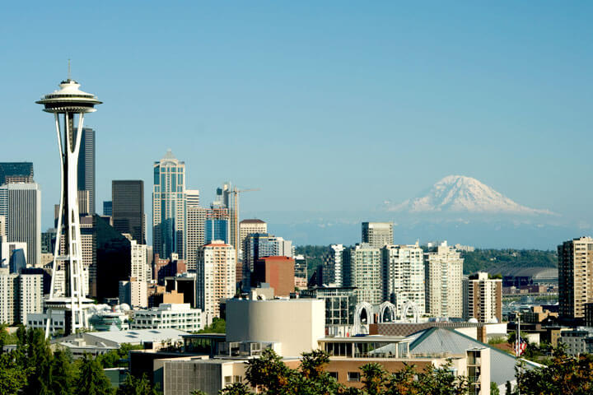

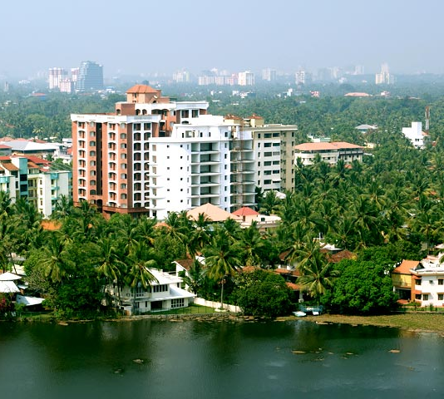

KANSAS CITY
2101 Broadway, Ste 31 Kansas City, MO 64108
SEATTLE
1201 Western Ave. #350 Seattle, WA 98101
(816) 398-8949
(855) 864-9929
ST. LOUIS
111 Westport Plaza Dr., Ste 600 St. Louis, MO 63146
KOCHI
33/2361 B5 Jacob Towers Kochi, India 682019
HERRLIBERG
Ackerstrasse 13 8704 Herrliberg, Switzerland
(314) 696-0030
+91 484-280-3193
+41 435-004-265

Slide 5






CAPABILITIES
Cloud
Digital Strategy
Business Solutions
Digital Insights
App Development
User Experience (UX)
Immersive Experiences
Security

Slide 6
Agenda
There are 2 paths
Technical Path
Focused on follow-the-data from data source through data experience
Technical resources will be introduced to a variety of Azure Products
Business Path
Concentrates on the business problem and how to socialize the results of machine learning
Provides business users insight into the opportunities provided by data science

Slide 7
Use Case – Business Problem Propensity Modeling
A marketing manager for a bike manufacturer has a limited budget to run a mailing campaign. To maximize ROI, the marketing manager wants to send the campaigns to buyer most likely t make a purchase.
Inputs:
Sales transaction data about customers that bought bikes in the past Data from previous marketing campaigns showing which customers were targeted and whether they responded Consumer lists from a 3rd party with demographic and credit history
Outputs:
The training data has one output showing whether the customer bought a bike or not. The output of the model shows the probability that the given customer will buy a bike.

Slide 8



At-risk customers
Empowered Agents
Segmentation Model
High-value Customer Agents
Calls Company
CM
SM
PM
Propensity Model
Churn Model
Other Agents

Slide 9
Technical Path
What tools accelerate the delivery of machine learning algorithms?

Slide 10
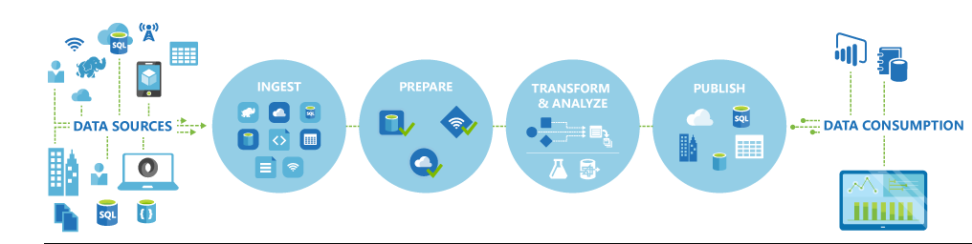
AGENDA SLIDE
We will use:
Azure Data Factory to retrieve on-premises data
Store the data on Azure Storage Blob
Ingest data from Azure Blob into AzureML
Create a predictive model and operationalize it through an API
Consume the API in Excel and Power BI

Slide 11
AzureML
Building the model

Slide 12
AzureML – Propensity Model Demo
Data Analysis
Drag BikeBuyer data onto canvas and visualize - note no missing values
Note last column Bike Buyer – the label
Note yearly income – not normal – some aglos require normal dist (Age has same symptoms)
Show box and whisker and explain. Outliers are 1.5 * IRQ (75th percentile – 25th percentile)
Correct income/Age with Apply Math Operation – Log10. Outlier on box whisker plot is gone. Preserved all the data with this transformation without losing an information!
Notes:
Buyer Propensity Model - US - Demo1
Log10 – remember to configure the results in place

Slide 13
AzureML – Propensity Model Demo
Feature Selection
Finds the set of variables that are highly correlated with the target label (Bike Buyer) with low correlation between the other variables.
Experiment with the different scoring options during experimentation
Splitting Data
2 methods demonstrated
Split data
Cross validation
Notes:
Log10 – remember to configure the results in place

Slide 14
AzureML – Propensity Model Demo
Model Development
Classification typically start with logistic regression
Boosted tree have become more common
Compare Models
AzureML Evaluate Model provides a number of useful metrics
Accuracy, AUC, F1 and more
Accuracy measures how well the model correctly identifies buyers and non-buyers
Because of class imbalance, propensity models should not be evaluated on accuracy
Most of the records represent non-buyers. A model could simply always predict 0 for non-buyer and be right 90% of the time!
Area Under the Curve (AUC) and F1 are much better metrics when the data is imbalanced
Notes:
Log10 – remember to configure the results in place

Slide 15
AzureML – Propensity Model Demo
Model Results
Model | Data Split | Feature Selection | Accuracy | AUC | F1
Boosted Tree | Split | ✓ | 91.9% | 79.4% | 0.432
Boosted Tree | Split |  | 92.3% | 85.3% | 0.481
Boosted Tree | Cross Validated |  | 90.8% | 83.8% | 0.454
Logistic | Split |  | 91.4% | 67.7% | 0.032
Notes:
Log10 – remember to configure the results in place
Feature Selection did not work – likely because there were not that many variables.

Slide 16
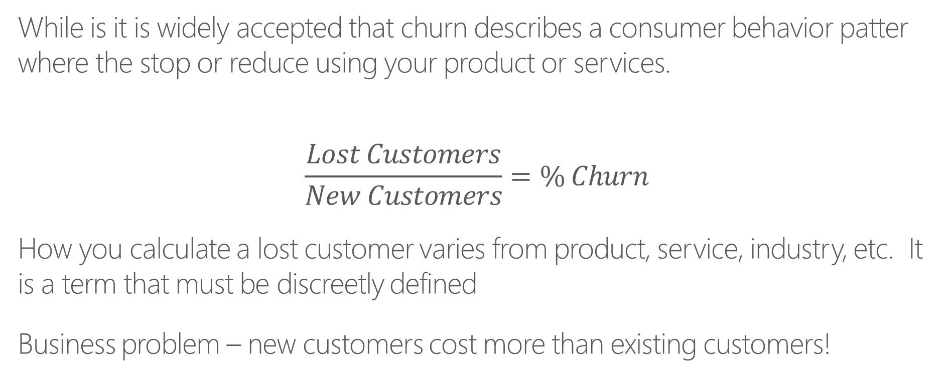
AzureML – Churn Model Demo
While is it is widely accepted that churn describes a consumer behavior patter where the stop or reduce using your product or services.
$$\frac{Lost Customers}{New Customers}=\% Churn$$
How you calculate a lost customer varies from product, service, industry, etc. It is a term that must be discreetly defined
Business problem – new customers cost more than existing customers!
Notes:
Churn definition see http://customer-churn.com/

Slide 17
Churn Model – Use Case
Data selected from 2009 KDD competition
The data was collected from a telecommunications company, Orange in France.
The goal is to build an effective machine learning model for predicting churn, willingness to buy new products/services and opportunities for upselling.
In this exercise we focus on customer churn.
Notes:
KDD Cup is the annual Data Mining and Knowledge Discovery competition organized by ACM Special Interest Group on Knowledge Discovery and Data Mining, the leading professional organization of data miners. (SIGKDD)
The Association for Computing Machinery (ACM) is widely recognized as the premier membership organization for computing professionals, delivering resources that advance computing as a science and profession; enabling professional development; and promoting policies and research that benefit society.

Slide 18
AzureML – ChurnDemo
Data Engineering
Columns 1-190 are numeric, the rest are categorical.
Split the data between numeric and categorical
Remove numerical variables that are all or nearly all 0s (added a branch showing how to do this in R)
Apply a Math operation to add +1 to each numeric variable
Allows you to distinguish between a 0 in the data source vs. the substitution value of 0 when the missing data substitution is made later.
Apply the Clean Missing Data module to sub 0 for all missing numeric values
Bin the numeric column variable values into 50 equally spaced bins
This sometimes helps the accuracy of machine learning algorithms – always experiment to determine the best way to proceed!
Notes:
Get data here: http://www.kdd.org/kdd-cup/view/kdd-cup-2009/Data
Data file name : orange_small_train.data

Slide 19
AzureML Churn Demo
Categorical Data
Use Clean Missing Data to replace missing data with 0
Use Edit Metadata to ensure all categorical variables have the data type Categorical
Join Data
Combine the numerical and categorical columns together using Add Columns.
Add labels variable to combined dataset
A file consisting of one column with values of -1 (did not churn) and +1 (customer churned)
Change the name of the label from Col1 to ChurnLabel

Slide 20
AzureML Churn Demo
Algorithm Development
2 classification algorithms are evaluated
Two Class Boosted Decision Tree and Two Class Decision Forest
Split the data into test and train
Run the models and review the results
Notes:
The key difference between the 2 models is:
In boosted decision tree algorithms multiple decision trees are grown in a series such that the output of one tree is the input to the next tree (boosting approach to modeling)
Decision Forest algorithm grows each decision tree independently of one and other. Each tree in the ensemble uses a sample of data drawn from the original dataset. (Bagging approach of ensemble modeling)

Slide 21
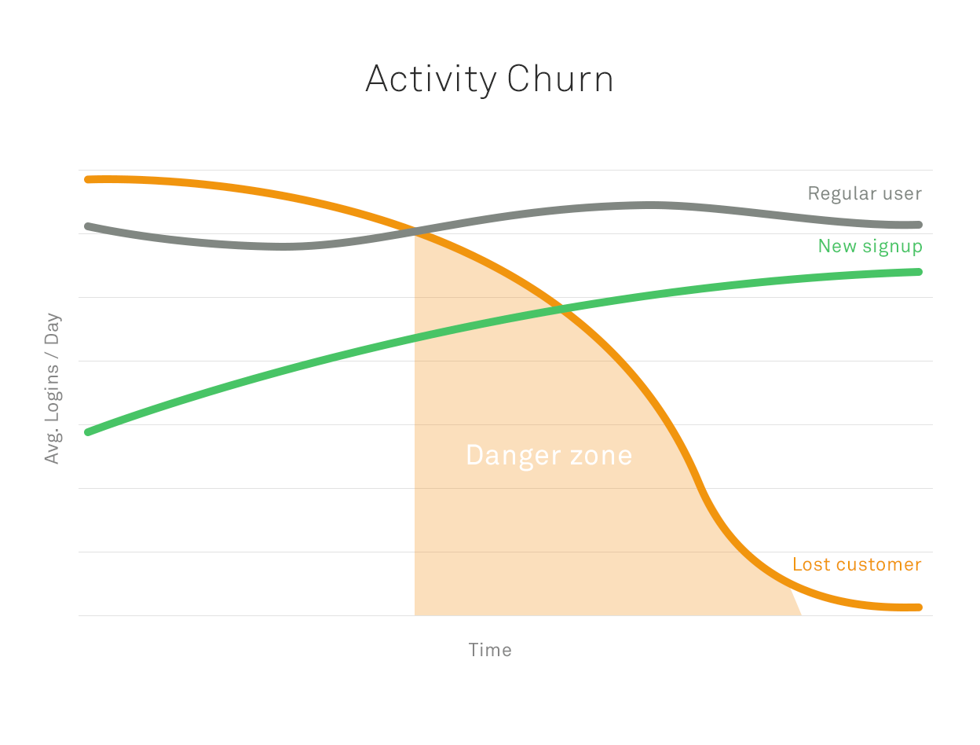
Notes:
http://businessforecastblog.com/whats-the-lift-of-your-churn-model-predictive-analytics-and-big-data/

Slide 22
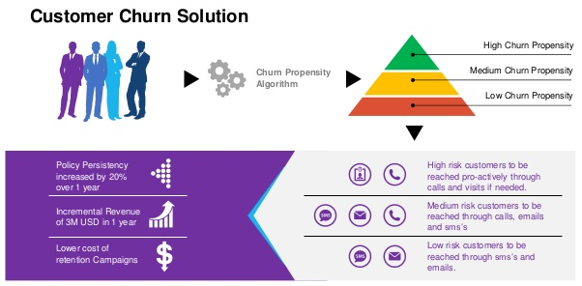

Slide 23
AzureML – Segmentation Demo
Use Case Scenario
From a wholesale dataset, segment the customers into distinct classes.
Notes:
Data source: https://archive.ics.uci.edu/ml/datasets/Wholesale+customers

Slide 24
AzureML – Segmentation Demo
Data Engineering
Columns 1-190 are numeric, the rest are categorical.
Split the data between numeric and categorical
Remove numerical variables that are all or nearly all 0s (added a branch showing how to do this in R)
Apply a Math operation to add +1 to each numeric variable
Allows you to distinguish between a 0 in the data source vs. the substitution value of 0 when the missing data substitution is made later.
Apply the Clean Missing Data module to sub 0 for all missing numeric values
Bin the numeric column variable values into 50 equally spaced bins
This sometimes helps the accuracy of machine learning algorithms – always experiment to determine the best way to proceed!
Notes:
Get data here: http://www.kdd.org/kdd-cup/view/kdd-cup-2009/Data
Data file name : orange_small_train.data

Slide 25
Business Problem
How can I improve my business?

Slide 26
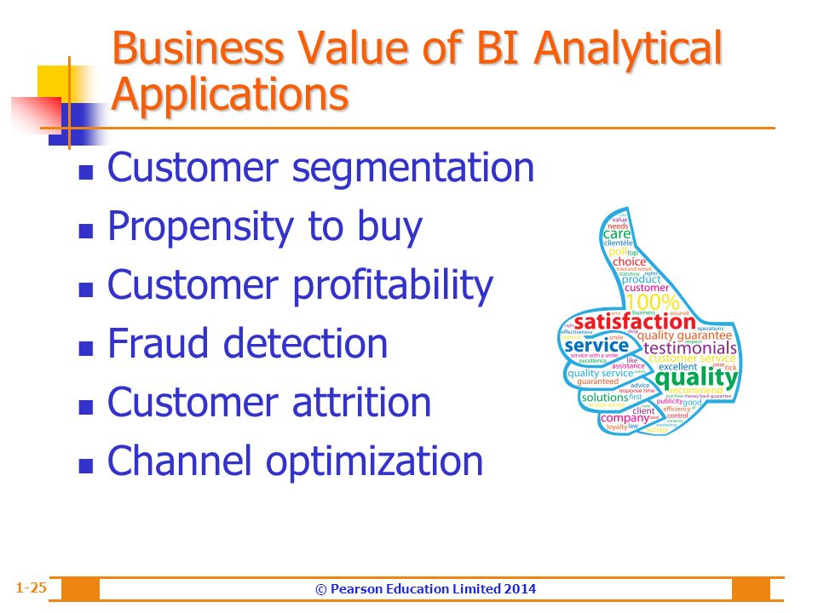

Slide 27
AGENDA SLIDE

Slide 30
Setup/Prep Requirements
Start DSVM on Azure DI Subscription
Check to see if Integration Runtime is working (shortcut on desktop)
Public IP: 40.76.18.186
Using the Azure Portal, ensure czwADF1 Pipeline is working

Slide 31
DEMO
Summary
This is a buyer propensity model that predicts which customers are most likely to buy bikes. This is a good example of a customer targeting model that is widely used in Marketing. It uses 2 binary classification algorithms namely Logistic Regression and Boosted Decision Trees.
**Inputs:**
The input data is the BikeBuyer dataset that has historical sales data on a set of fictitious customers. This data includes demographic variables such as marital status, gender, yearly income, number of children, occupation, age, etc. Other input variables include home ownership status, number of cars, and commute distance.
**Outputs:**
The training data has one output - a single binary variable showing whether the customer bought a bike or not. The output of the model is the probability of purchase. So for a given customer the model shows the probability that the given customer will buy a bike.

Slide 32
Demo – Detailed Steps
Search for interesting data in data catalog
Open Azure Data catalog app on laptop and search for bike
Show the columns in the CSV
Note that cweaver@valorem is the person to contact for access
Go to Azure portal and open Blob storage
Note that the data could be downloaded by the Download link or the URL
Introduce Data Factory to show how the data gets into Blob (recall the data comes from the DSVM VM, not the laptop!)
Recall the VM must be running (verify the Integration Runtime is enabled)
Data is in the czwdemo container
DSVM should be running. Make sure Integration Runtime is status green

Slide 33
Demo – Detailed Steps, Cont’d
Open AzureML Studio
Open Buyer Propensity Model-US
Note that the data is retrieved directly from the Azure Blob storage
Briefly review the AzureML Model – visualize the performance
Show Predictive Experiment tab
Mention it is created automatically. Only mod was the selection of output variables
Go to Web Services and select Buyer Propensity Model – US [predictive exp]
Show the Test Button but do not execute (just to save time)
Open the Excel 2013 or Later link (enable editing when prompted)
Use Sample Data. Select N1 as Output (ensure Include headers is selected)
Go to Azure Blob czwdemo and download BikeBuyerRandomTestData.csv.
Copy the random data into the Excel Algorithm file and run the prediction (note, Excel seems to hang – give it a minute – it’ll free up!) Move to PBI

Slide 34
Demo – Detailed Steps, Cont’d
Open BikeBuyer PBI File
Highlight the data on the dashboard where the scored probabilities from the Excel file are illustrated
Note the fields are the same that we saw throughout the demo
Started at Data Catalog, through Data Factory, Azure Blob, AzureML, Excel and finally into Power BI

Slide 35


What we learned
Azure Data Factory used to collect local data
Store data on Azure Storage
Use cloud data to build a predictive model
Deploy predictive model and an API
Consume the API in Excel
Leverage Power BI to democratize the results from machine learning investments
©Valorem

Slide 36
THANK YOU
Cliff Weaver
Data Scientist
cweaver@valorem.com
(816) 406-1501

Slide 37
My Notes
Data questions to always ask:
What kind of information is captured in each column?
How specifically is each variable captured?
Are missing values high informational content?
Are the outliers meaningful or data entry errors?
Should the variables be used as provided or should new variables be derived from the given data?
What is the distribution or each variable values?
Numeric, ordinal or categorical? If categorical, are there industry standards that groups this data?

